Slide 1
Assignment 1, CS683 (NLP),
BY-MAYANK GUPTA
Roll No.: 2101117
GROUP-CS41
CLASS- B.TECH-4TH Year

Slide 2
Data Preprocessing
Data Acquisition and Preparation:
The analysis utilizes the Cornell Movie Review Dataset, which has been converted into CSV format for ease of manipulation.
The dataset underwent thorough cleaning to eliminate unnecessary whitespace, special characters, and other inconsistencies, ensuring the text is suitable for analysis.
2. Data Labeling:
An additional column has been incorporated into the CSV file to represent the sentiment polarity:
Positive reviews are assigned a label of 1.
Negative reviews are labeled as 0.
This labeling facilitates the training of a binary classification model.
3. Dataset Structure:
The cleaned data is organized into a DataFrame and divided into three distinct sets for modeling:
Training Set: Comprises the first 4,000 positive and 4,000 negative reviews to train the model.
Validation Set: Contains the next 500 positive and 500 negative reviews to tune hyperparameters and prevent overfitting.
Test Set: Consists of the final 831 positive and 831 negative reviews, used to evaluate the model's performance post-training.

Slide 3
Vectorization and Embedding:
Text Vectorization: To process text data effectively with neural networks, we transform textual content into a numerical format through text vectorization. In this code, this is done using TensorFlow’s TfidfVectorizer, which applies the Term Frequency-Inverse Document Frequency (TF-IDF) method. Max Features: The max_features parameter is set to 5,000, which limits the vocabulary to the most significant words based on their TF-IDF scores. This ensures the model focuses on relevant features and reduces noise from less important words. The resulting numerical representation captures the importance of words within the dataset, enabling efficient processing.
Embedding Layer:
After vectorization, the next step involves mapping integer sequences to dense vectors. While the code does not explicitly include a Keras embedding layer, it converts the sparse matrix to a dense format using the toarray() method.

Slide 4
Model Architecture
Input Layer:
Accepts input in the form of a dense matrix, derived from TF-IDF vectorization of raw text reviews.
Text Vectorization Layer:
TF-IDF Vectorizer: Converts text data into numerical format using the Term Frequency-Inverse Document Frequency (TF-IDF) method. The vocabulary is limited to the 5,000 most significant words to focus on relevant features while reducing noise.
Dense Layers:
First Dense Layer:
256 units with ReLU activation, capturing complex interactions within the data.
Dropout Layer:
40% dropout to prevent overfitting.
Second Dense Layer:
128 units with ReLU activation, continuing to refine feature learning.

Slide 5
4.Dropout Layer:
40% dropout to further mitigate overfitting.
5.Third Dense Layer:
64 units with ReLU activation, providing additional depth for feature extraction.
6.Dropout Layer:
30% dropout to enhance generalization.
7.Output Layer:
A single neuron with a sigmoid activation function for binary classification (positive or negative sentiment).
3. Compilation:
The model is compiled using the Adam optimizer with a learning rate of 0.0001, binary cross-entropy as the loss function, and accuracy as a performance metric.
4. Training Configuration:
Early Stopping: Utilized to prevent overfitting by monitoring validation loss with a patience of 2 epochs, restoring the best weights.
Class Weighting: Class weights are applied to handle class imbalance, with the positive class weighted higher.

Slide 6
Training and Testing
The model was trained on a balanced dataset comprising 8,000 samples, with 4,000 samples each from the positive and negative polarity categories. The training process involved multiple epochs to ensure the model effectively learned the underlying patterns in the data.
During training, the model was validated using a separate validation set consisting of 1,662 samples, with 831 samples from each polarity. This allowed for continuous monitoring of the model's performance and adjustment of the learning process.
After training, the model was evaluated on a test set comprising 1,662 samples, again balanced with 831 samples from both positive and negative polarities. The predicted probabilities were rounded to generate final class labels for each sample.

Slide 7
Results
The model achieved the following final performance metrics on the test set:
True Positives (TP): 703
True Negatives (TN): 551
False Positives (FP): 280
False Negatives (FN): 128
Precision: 71.516%
Recall: 84.597%
F1-score: 77.508%

Slide 8
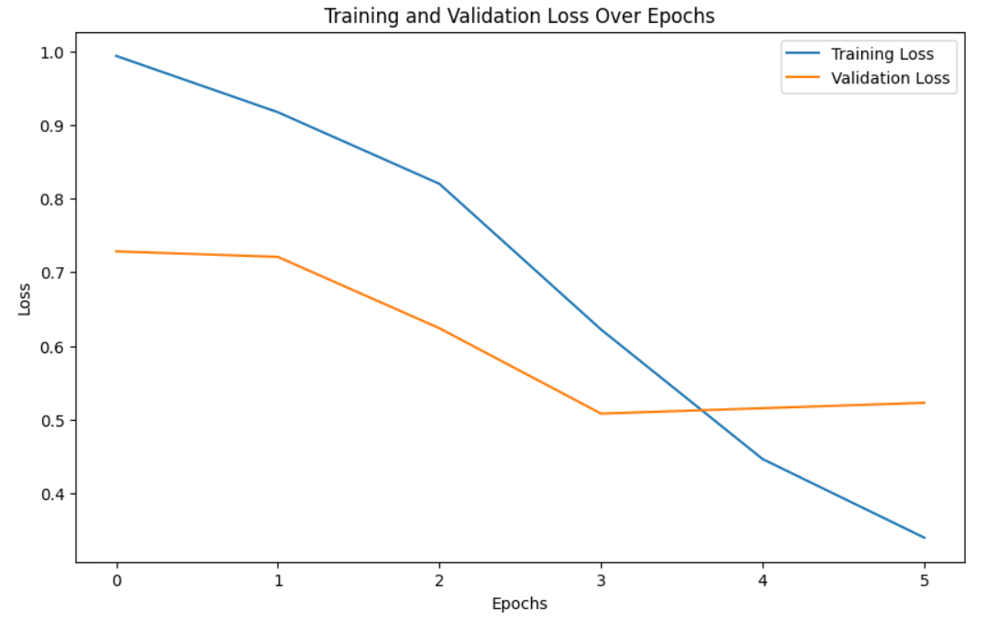
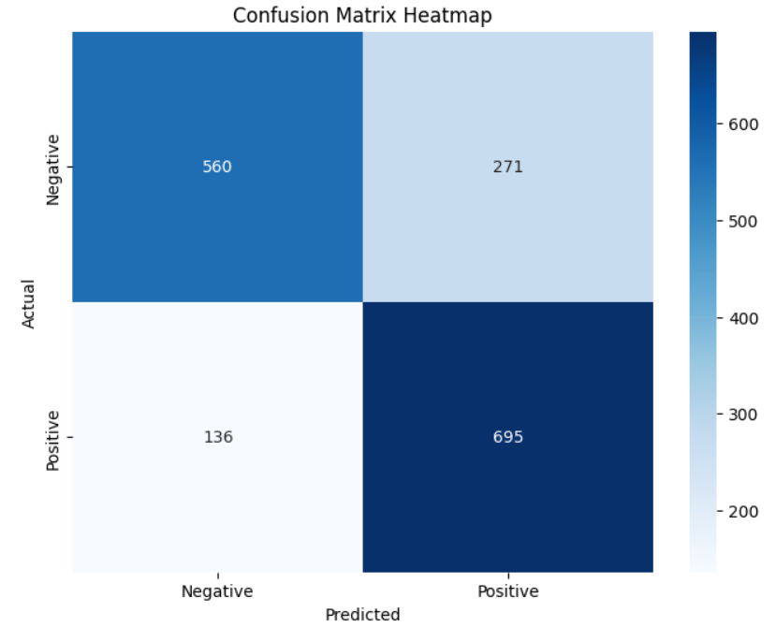

Slide 9
Logistics
Python3
Tensorflow
Pandas
Sklearn
Seaborn
Matplotlib
Link to Google Colab: https://colab.research.google.com/drive/19NzCOgSFg_MlpfZqRGAZbymp1-UjZ7ol?usp=sharing
Link to Github Repository:
https://github.com/MayankGuptaaa/Sentiment-Polarity-Classification-Assignment

